Slide 1

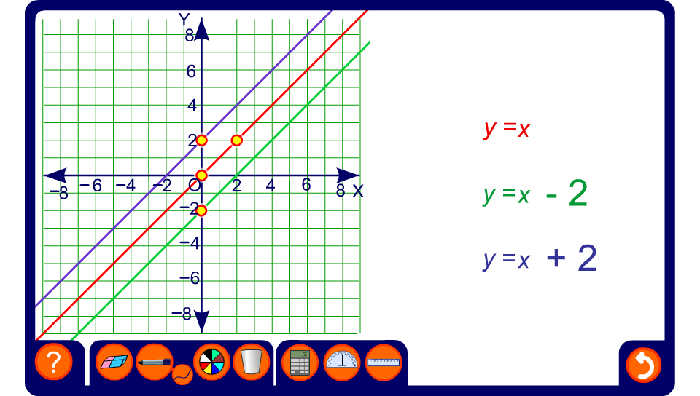


Investigating parallel lines

